Slide 1
AWS Proposed Architecture
13th Dec’24

Slide 2
Overview - CIAM Data Transformation Process
We've recently seen higher costs stemming from the use of ad-hoc interactive sessions with high configurations (G.8*100).
We have conducted an exploration of alternative approaches to the data transformation process along with GLUE jobs.
Currently, our script-based GLUE Jobs are running with lower configurations(G.2*10) and performing well post optimization of queries.
DATA SIZE | CONFIGURATION | EXECUTION TIME | TENTATIVE COST
For 13 Months | G.2*10 | ~ 2 Hrs. | $18
For 1 Month | G.2*10 | ~ 1 Hrs. | $9
THE FOLLOWING APPROACHES WERE ALSO EXPLORED.
EMR on EC2
EMR on EC2

Slide 3
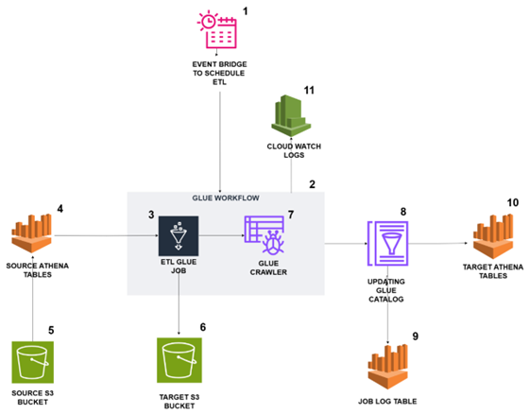
Existing Solution GLUE – Work Flow & Architect
EventBridge triggers the Glue workflow based on the scheduled time
The Glue workflow is triggered by EventBridge and initiates the run
A Glue job starts running within the Glue workflow using an On-Demand trigger
The Glue job executes Athena queries to read data from the source tables
The Glue job fetches data from the source S3 path based on the queries executed in Athena
The data from the source tables is loaded into the target S3 path as Parquet files, organized into partitioned folders
Upon successful completion of the Glue job, the Glue crawler is triggered and starts running.
The job log table is created, containing runtime information and table counts.
The target tables are available in Athena, where the data can be queried.
CloudWatch stores logs for both the Glue jobs and the Glue crawler.
1
Placeholder for text
Placeholder for text
Placeholder for text
Placeholder for text
2
3
4
5
6
7
8
9
10

Slide 4

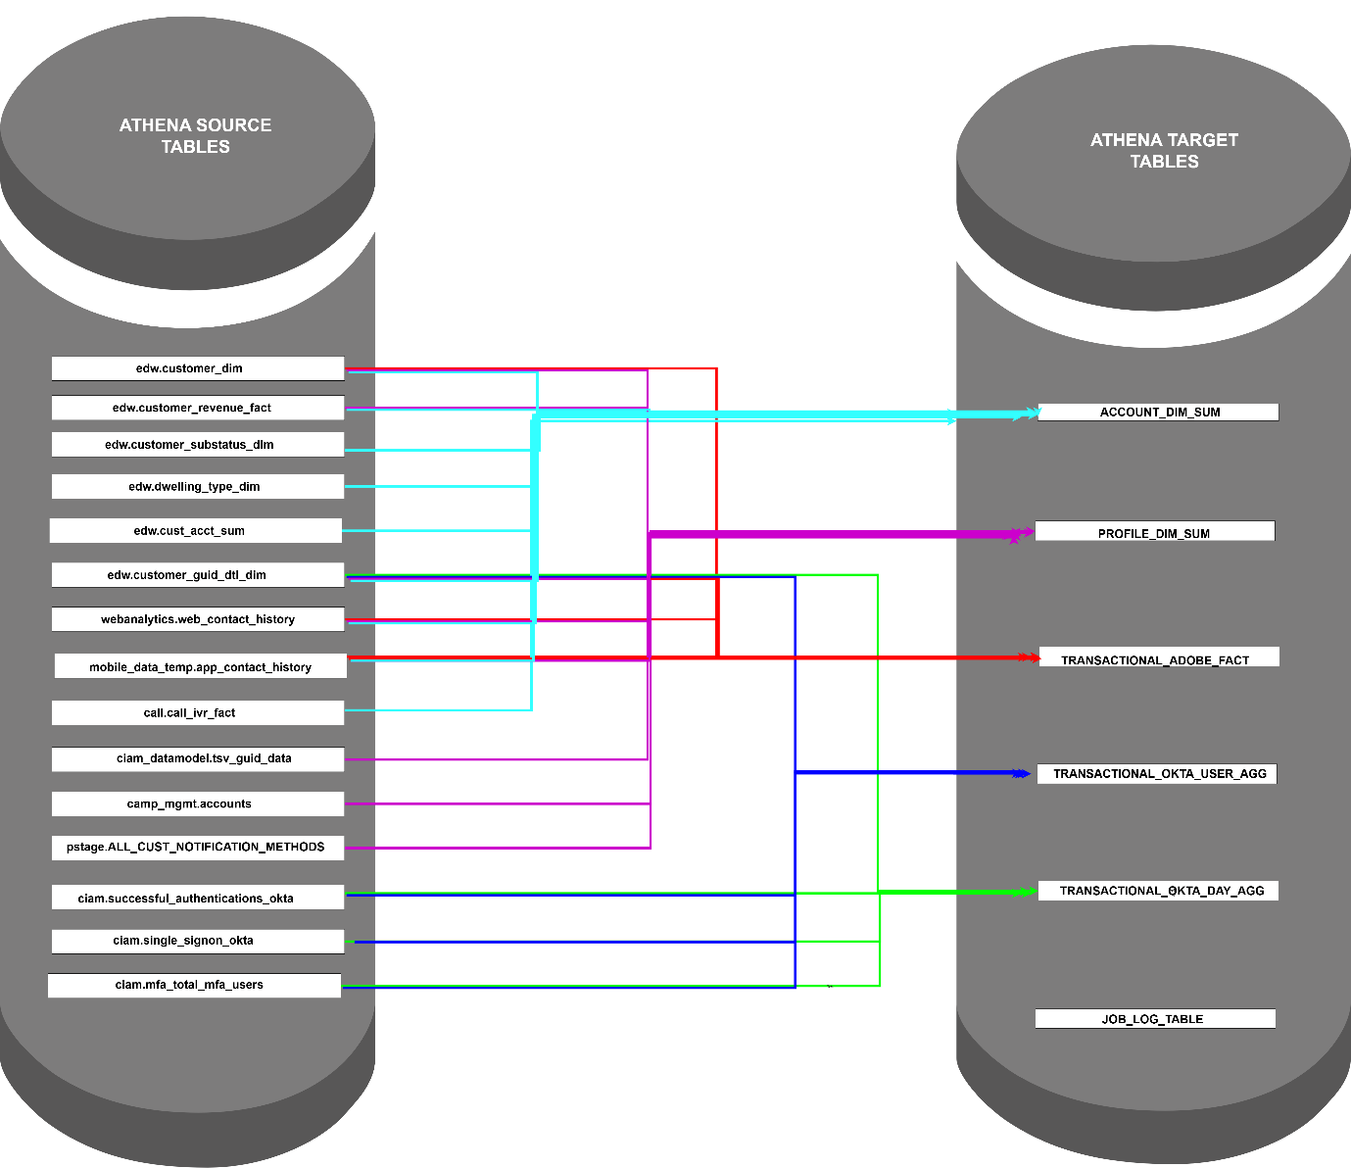



Existing Solution GLUE – Work Flow & Architect
SOURCE DATABASES:
edw, webanalytics, mobile_data_temp,call,ciam, camp_mgmt, pstage, ciam_datamodel
SOURCE TABLES:
edw.customer_dim, edw.customer_revenue_fact, edw.customer_substatus_dim,edw.dwelling_type_dim, edw.cust_acct_sum, edw.customer_guid_dtl_dim, webanalytics. web_contact_history, mobile_data_temp.app_contact_history, call.call_ivr_fact, ciam_datamodel.tsv_guid_data, camp_mgmt.accounts, pstage.ALL_CUST_NOTIFICATION_METHODS, ciam.successful_authentications_okta, ciam.single_signon_okta, ciam.mfa_total_mfa_users
TARGET DATABASE:
ciam_datamodel
TARGET TABLES:
account_dim_sum, profile_dim_sum, transaction_adobe_fact, transaction_okta_use_agg, transaction_okta_day_agg, job_log_table

Slide 5
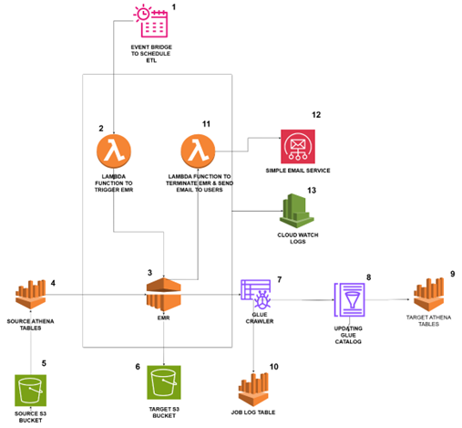
Proposed Solution EMR On EC2 – Work Flow & Architect
Based on the specified schedule, EventBridge triggers the Lambda Function, initiating the process
The Lambda Function then triggers the EMR cluster, which starts running.
The EMR cluster launches the required EC2 instances and starts processing.
PySpark script is executed on the EMR cluster, which reads data from the Athena tables.
The PySpark script fetches data from the source S3 path using Athena queries.
The data retrieved from Athena is loaded into the target S3 path as parquet files, organized in partitioned folders.
Once the PySpark script completes execution on EMR, a Glue Crawler is triggered to run.
The Glue Crawler populates the tables in the AWS Glue Data Catalog.
The newly populated target tables in Glue can now be queried using Athena.
The PySpark script on EMR generates a Job Log Table containing runtime information and table counts.
The Lambda Function terminates the EMR cluster after successful execution of the PySpark script.
Through SES, Lambda Function sends an email to the users, notifying them of the job status and providing the job log table details
All logs for the Lambda Function and EMR are stored in CloudWatch for monitoring and troubleshooting
1
Placeholder for text
Placeholder for text
Placeholder for text
Placeholder for text
2
3
4
5
6
7
8
9
10
11
12
13

Slide 6
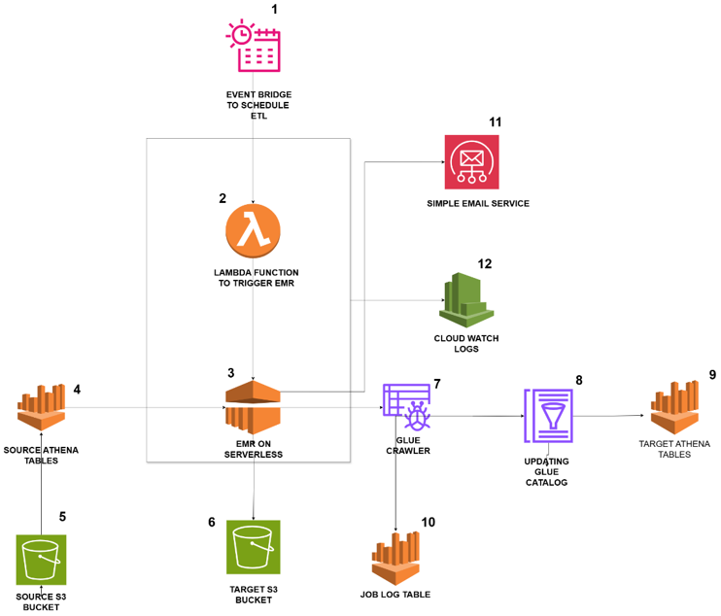
Proposed Solution EMR Serverless – Work Flow & Architect
Based on the specified schedule, EventBridge triggers the Lambda Function, initiating the process.
The Lambda Function then triggers the EMR Serverless, which starts running.
The EMR serverless gets triggered from lambda and it starts executing the PySpark Script.
PySpark script is executed on the EMR cluster, which reads data from the Athena tables.
The PySpark script fetches data from the source S3 path using Athena queries.
The data retrieved from Athena is loaded into the target S3 path as parquet files, organized in partitioned folders.
Once the PySpark script completes execution on EMR, a Glue Crawler is triggered to run.
The Glue Crawler populates the tables in the AWS Glue Data Catalog.
The newly populated target tables in Glue can now be queried using Athena.
The PySpark script on EMR generates a Job Log Table containing runtime information and table counts.
Through SES, PySpark script from EMR Serverless sends an email to the users, notifying them the job status and providing the job log table details.
All logs for the Lambda Function and EMR Serverless are stored in CloudWatch for monitoring and troubleshooting.
Placeholder for text
Placeholder for text
Placeholder for text
Placeholder for text
1
2
3
4
5
6
7
8
9
10
11
12

Slide 7
Estimated Costing for alternative solutions
COST TYPE | USAGE TYPE | EXECUTION TIME | REQUIRED TIME | GLUE COST (PROPOSED) | EMR EC2 COST | EMR SERVERLESS COST
One Time | Development Phase | ~6 Hrs/Day | 3 Week | $1222.2 | $96.768 | $114.471
One Time | Testing Phase | ~6 Hrs/Day | 1 Week | $407.4 | $32.256 | $38.162
Monthly | Production | ~1 Hrs/Day | Daily Basis | $264 | $46.08 | $54.51
 |  |  | Weekly Basis | $36
Configuration |  |  |  | G.2*10 | m5.xlarge 4 Nodes | Driver-4 vCPU Executer-8 vCPU

Slide 8
Thank you message
Name
Phone number
name.surname@eclerx.com
© 2024 eClerx. All rights reserved. This presentation and its contents are protected by copyright laws and international treaties. Unauthorized use, reproduction, duplication, or distribution of this material, in whole or in part, is strictly prohibited. No portion of this presentation may be copied, transmitted, or otherwise used, in any form or by any means—whether electronic, mechanical, or otherwise—without the express prior written consent of eClerx. Any unauthorized use or distribution of this material may result in legal action.

